Slide 1
Remodeling the Getty Provenance Index as Linked Open Data
Remodeling the GPI
as LOD
Ruth Cuadra Business Application Administrator Getty Research Institute
2016 Digital Provenance Symposium
Hosted by Carnegie Museum of Art
rcuadra @getty.edu

Slide 2
Overview
About the Provenance Index
Our Remodeling Project
Data Modeling: Integrating Auction Sales Catalogs and Dealer Stock Books
Developing a URI Scheme and Reconciling with Getty Vocabularies
Lessons Learned
Remodeling the GPI
as LOD
rcuadra @getty.edu

Slide 3
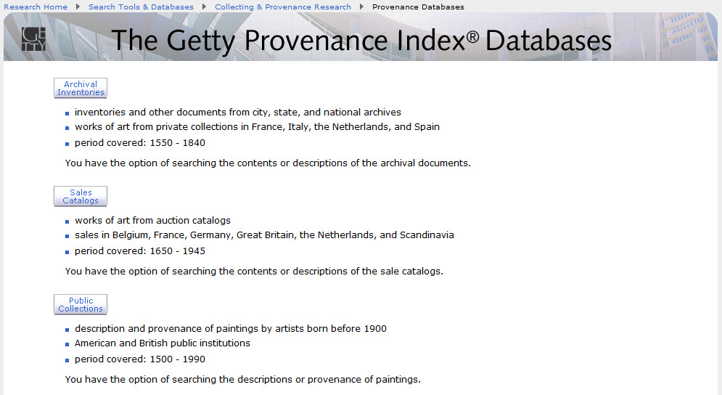
About the Provenance Index
8 databases
1.5 million records
Primarily Western European art
Variety of primary sources
Remodeling the GPI
as LOD
rcuadra @getty.edu

Slide 4
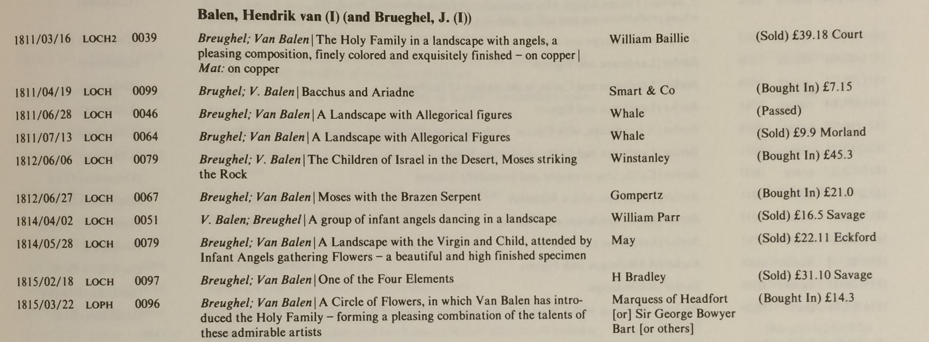
In the beginning…
Published as book series
Databases designed to support print publications
Remodeling the GPI
as LOD
rcuadra @getty.edu

Slide 5
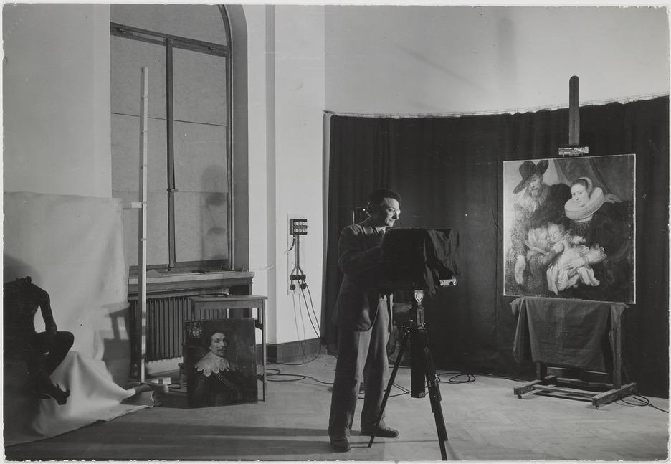
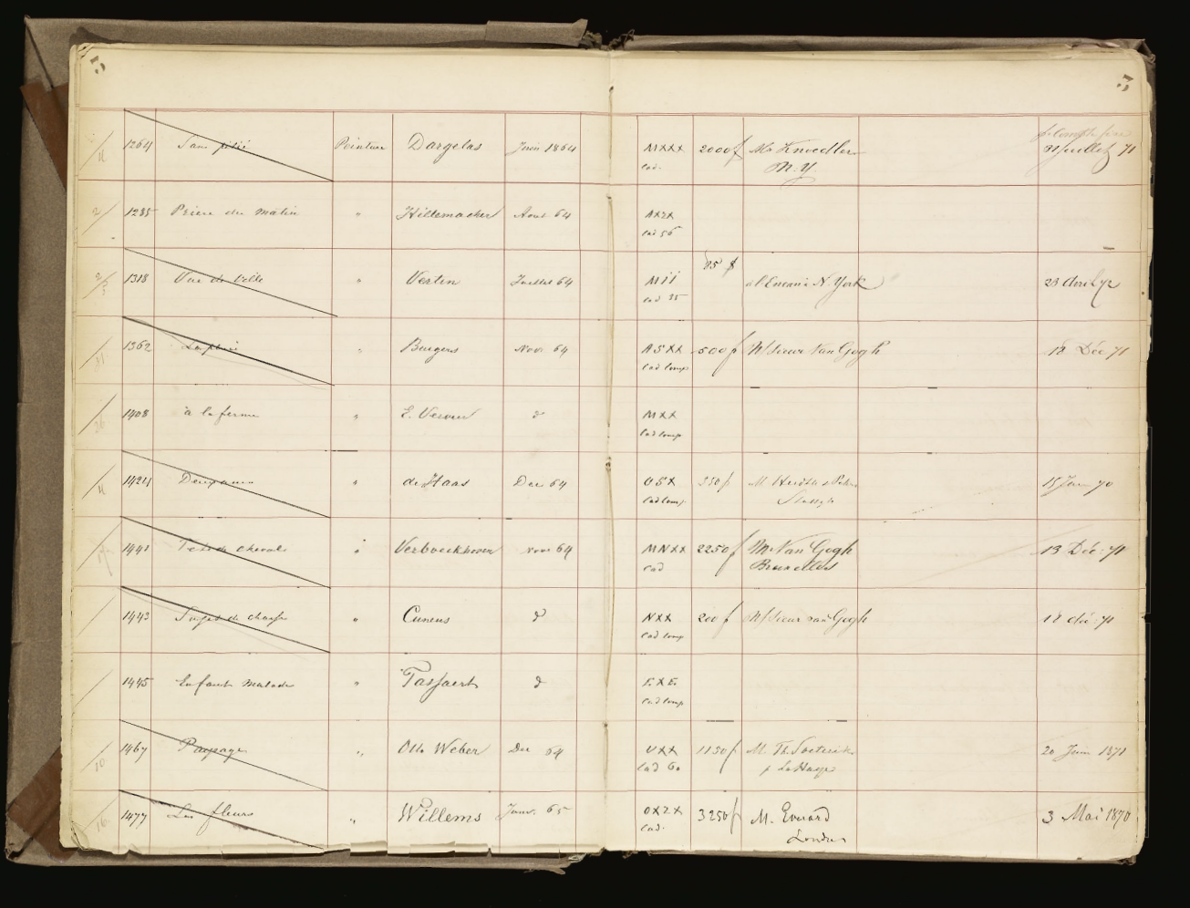
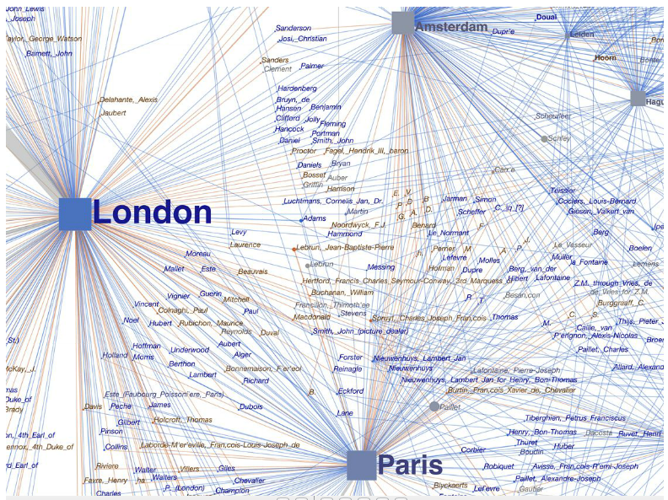
The
Remodeling Project: Goals
Improve accessibility
Improve usability
Strengthen relationships with other GRI materials
Explore research questions
Remodeling the GPI
as LOD
rcuadra @getty.edu

Slide 6
Remodeling Project: Timeline 2016-2018
Phase 1 | User Experience Research Data Modeling Software Architecture Planning Publications, Communications, DH Planning
Phase 2 | Software Development Documentation Research Projects
Phase 3 | Usability Testing Launch and Outreach
Remodeling the GPI
as LOD
rcuadra @getty.edu

Slide 7
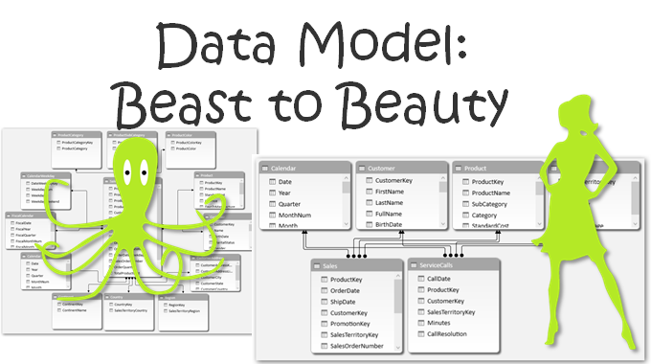
Remodeling Project: Phase 1
Remodeling the GPI
as LOD
rcuadra @getty.edu
Image credit: bit.ly/2dBnp8x

Slide 8
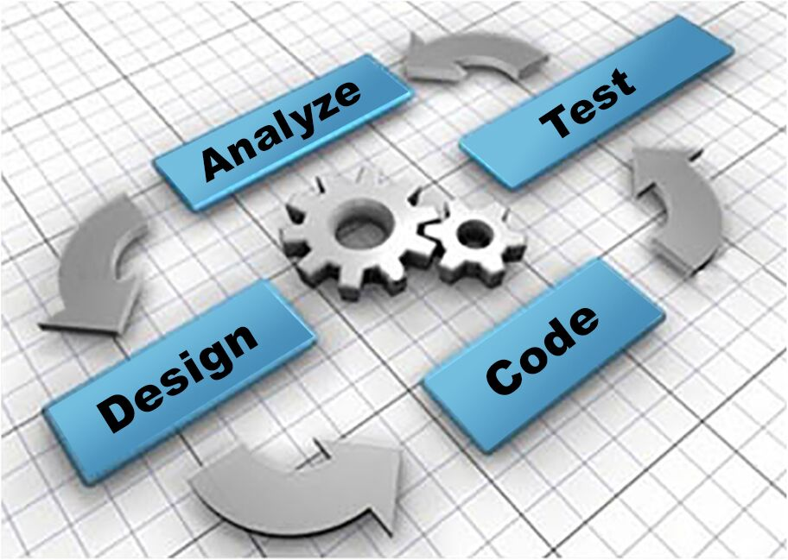
Remodeling Project: Phase 1
Remodeling the GPI
as LOD
rcuadra @getty.edu
Image credit: bit.ly/2e6nUKz

Slide 9
Remodeling Project: Phase 1
Remodeling the GPI
as LOD
rcuadra @getty.edu
Image credits: bit.ly/2d08bGY, bit.ly/2dFEJsg, bit.ly/2dFEJsg

Slide 10
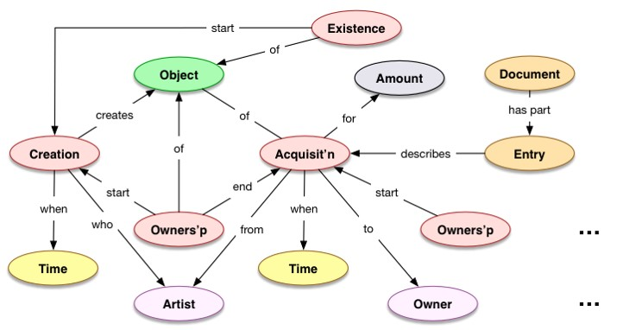
Data Modeling: Provenance Model
Remodeling the GPI
as LOD
rcuadra @getty.edu

Slide 11
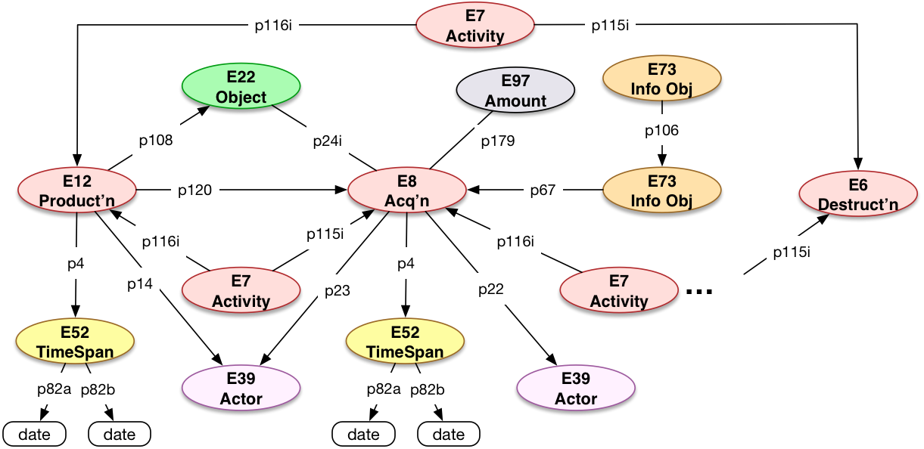
Data Modeling: Provenance Model (CRM)
Remodeling the GPI
as LOD
rcuadra @getty.edu

Slide 12
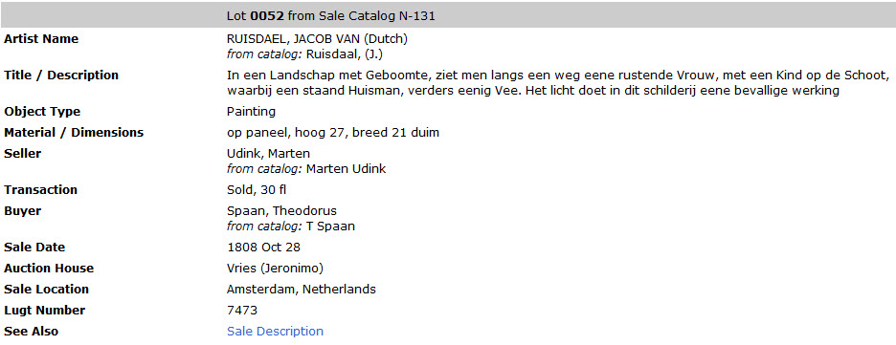
Data Modeling: Auction Sales Catalogs
Remodeling the GPI
as LOD
rcuadra @getty.edu

Slide 13
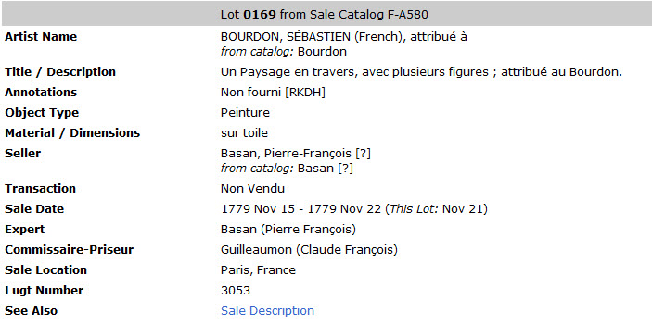
Data Modeling: Auction Sales Catalogs
Remodeling the GPI
as LOD
rcuadra @getty.edu

Slide 14
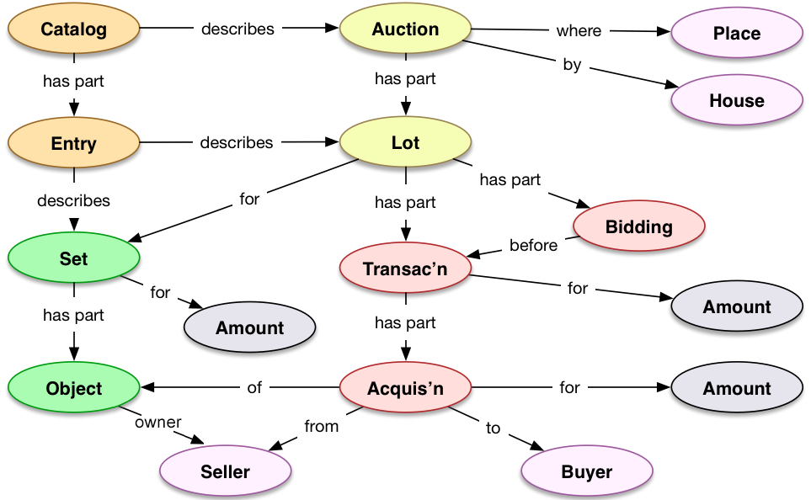
Data Modeling: Auction Sales Catalogs
Remodeling the GPI
as LOD
rcuadra @getty.edu

Slide 15
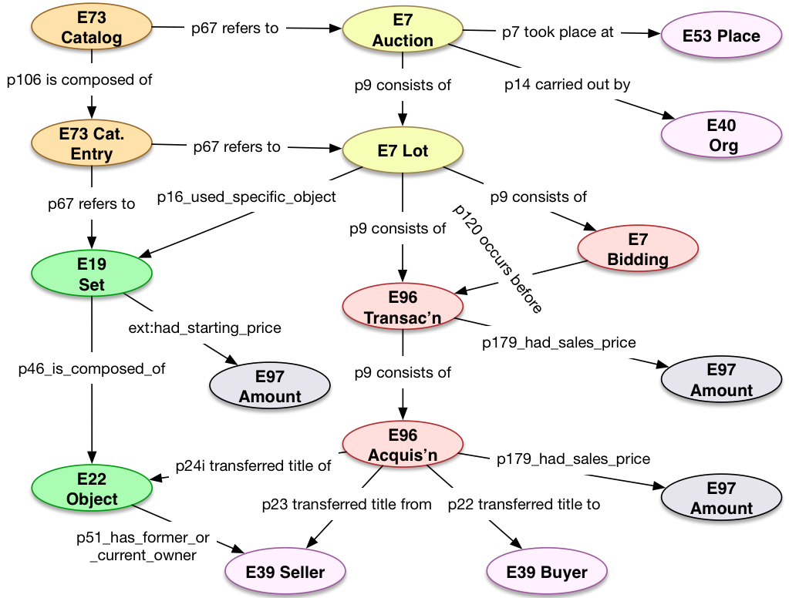
Data Modeling: Auction Sales Catalogs (CRM)
Remodeling the GPI
as LOD
rcuadra @getty.edu

Slide 16
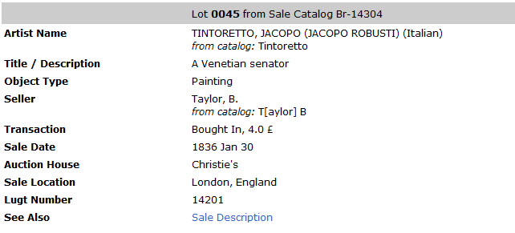
Data Modeling: Auction Sales Catalogs
Remodeling the GPI
as LOD
rcuadra @getty.edu

Slide 17
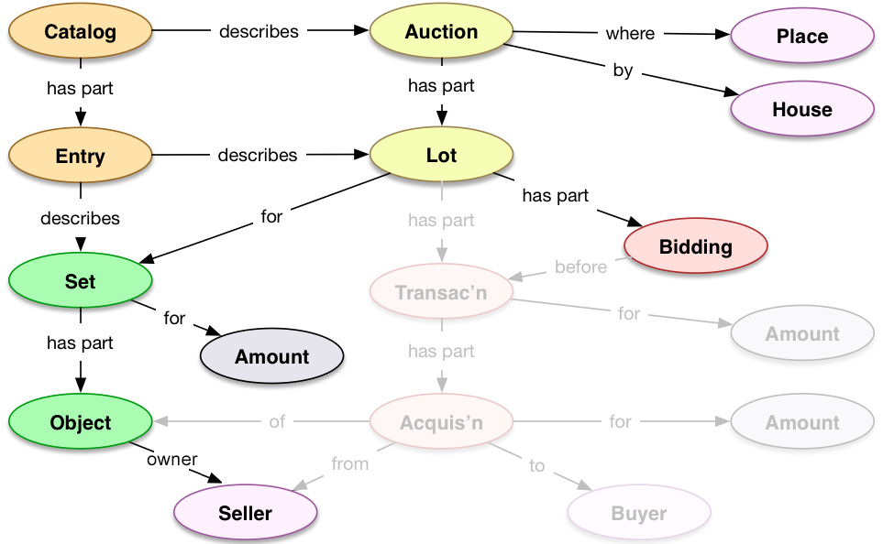
Data Modeling: Auction Sales Catalogs
Remodeling the GPI
as LOD
rcuadra @getty.edu

Slide 18
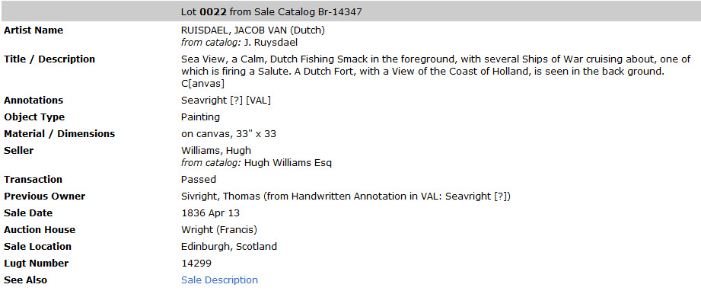
Data Modeling: Auction Sales Catalogs
Remodeling the GPI
as LOD
rcuadra @getty.edu

Slide 19
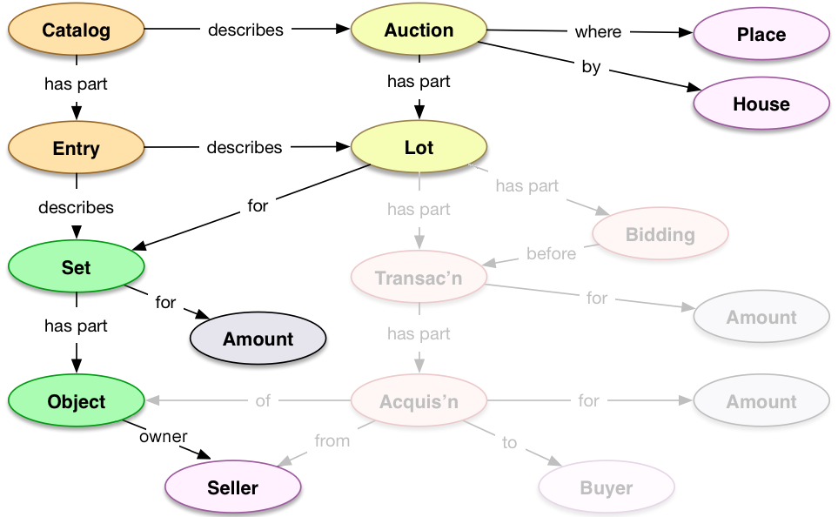
Data Modeling: Auction Sales Catalogs
Remodeling the GPI
as LOD
rcuadra @getty.edu

Slide 20
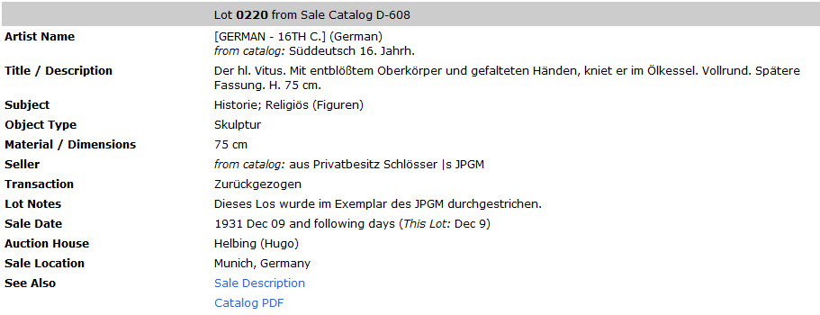
Data Modeling: Auction Sales Catalogs
Remodeling the GPI
as LOD
rcuadra @getty.edu

Slide 21
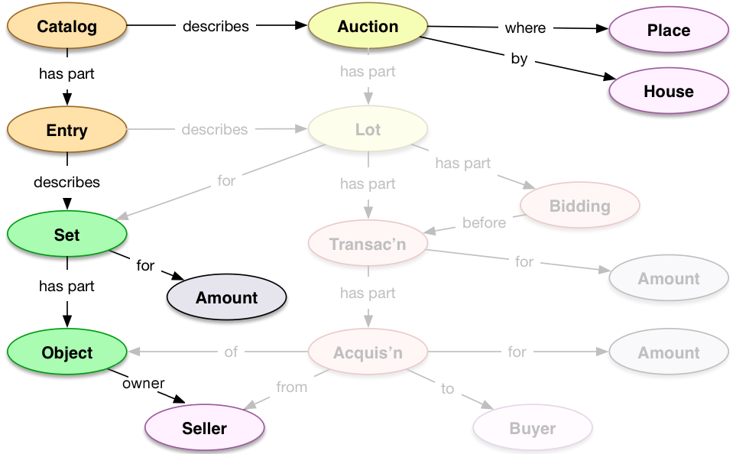
Data Modeling: Auction Sales
Remodeling the GPI
as LOD
rcuadra @getty.edu

Slide 22
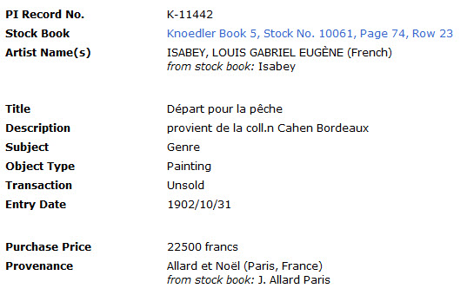
Data Modeling: Dealer Stock Books
Remodeling the GPI
as LOD
rcuadra @getty.edu

Slide 23
Data Modeling: Dealer Stock Books
Remodeling the GPI
as LOD
rcuadra @getty.edu

Slide 24
Data Modeling: Dealer Stock Books
Remodeling the GPI
as LOD
rcuadra @getty.edu

Slide 25
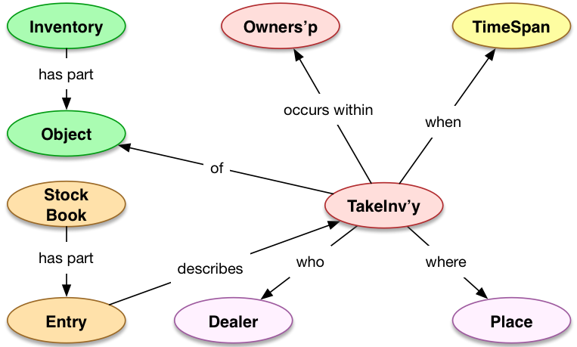
Data Modeling: Taking Inventory
Remodeling the GPI
as LOD
rcuadra @getty.edu

Slide 26
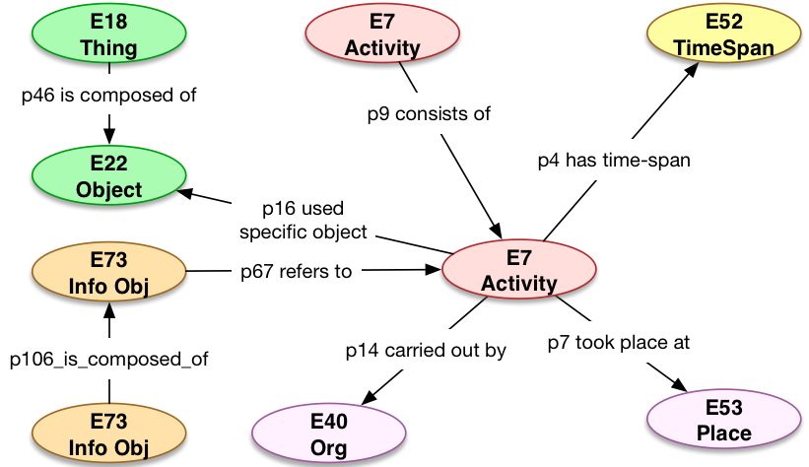
Data Modeling: Taking Inventory (CRM)
Remodeling the GPI
as LOD
rcuadra @getty.edu

Slide 27
Developing a URI Scheme
https://data.getty.edu/project/resourceType/identifier[/identifierPart]
Examples:
https://data.getty.edu/collection/painting/882 https://data.getty.edu/provenance/activity/d17382/a106
Remodeling the GPI
as LOD
https | Avoids passive mixed content errors; provides user privacy
data.getty.edu | Host will redirect or proxy requests
project | Allows simple rules for proxying; distinguishes source of data without relying on political constructs
resourceType | distinguishes and compartmentalizes the data within the project
identifier | a string that is unique within a resourceType
identifierPart | Repeatable component for sub-identifiers to break up the identifier into more granular pieces
rcuadra @getty.edu

Slide 28
Reconciling with Getty Vocabularies
People: ULAN (Union List of Artist Names)
Places: TGN (Thesaurus of Geographic Names)
Things: CONA (Cultural Object Name Authority)
Types of people, places, things: AAT (Art & Architecture Thesaurus)
Remodeling the GPI
as LOD
rcuadra @getty.edu

Slide 29
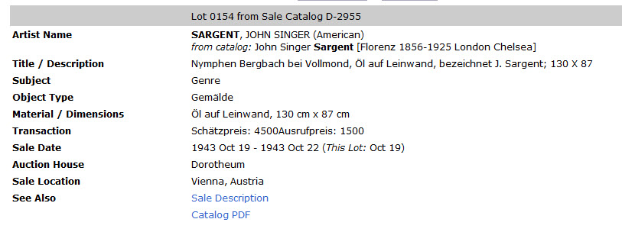
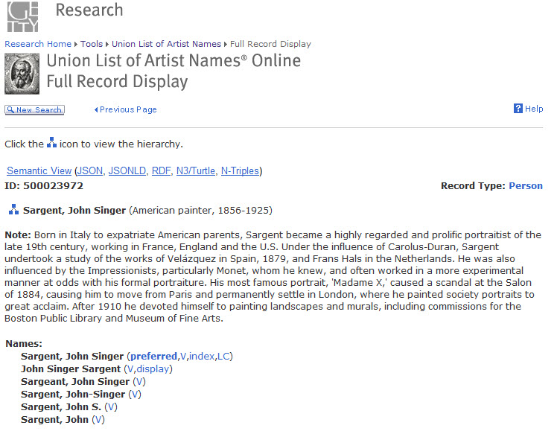
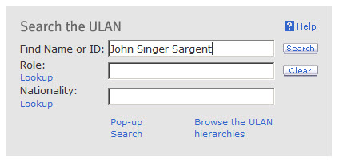
Reconciling with Getty Vocabularies
Remodeling the GPI
as LOD
rcuadra @getty.edu

Slide 30
Remodeling the GPI
as LOD
Lessons Learned
rcuadra @getty.edu

Slide 31
Lessons Learned
Need to focus on our goals … not on philosophical disagreements around ontologies
Remodeling the GPI
as LOD
rcuadra @getty.edu

Slide 32
Lessons Learned
Need to focus on our goals … not on philosophical disagreements around ontologies
Hard to align models while avoiding false precision
Remodeling the GPI
as LOD
rcuadra @getty.edu

Slide 33
Lessons Learned
Need to focus on our goals … not on philosophical disagreements around ontologies
Hard to align models while avoiding false precision
Get over the “need” for 100% precision, 100% coverage, 100% completeness
Remodeling the GPI
as LOD
rcuadra @getty.edu

Slide 34
Lessons Learned
Need to focus on our goals … not on philosophical disagreements around ontologies
Hard to align models while avoiding false precision
Get over the “need” for 100% precision, 100% coverage, 100% completeness
Start somewhere, then design, implement, learn, correct, and iterate
Remodeling the GPI
as LOD
rcuadra @getty.edu

Slide 35
s
Thank you!
Remodeling the GPI
as LOD
Ruth Cuadra / rcuadra@getty.edu
rcuadra @getty.edu

