Slide 1
Needles and Haystacks: finding the Northbrook collection
Tracey Berg-Fulton
Berg-fultont@cmoa.org
@BergFulton

Slide 2
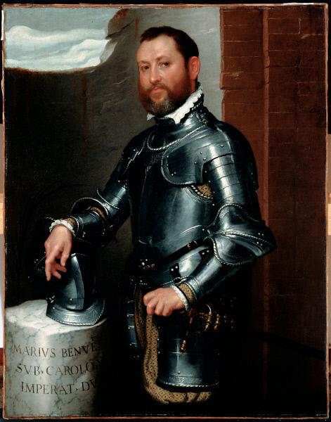
Background
British banking/political dynasty
Large collection, unusually well documented
Giovanni Battista Moroni, Portrait of Mario Benvenuti, c. 1560, The John & Mable Ringling Museum of Art, Bequest of John Ringling, 1936.

Slide 3
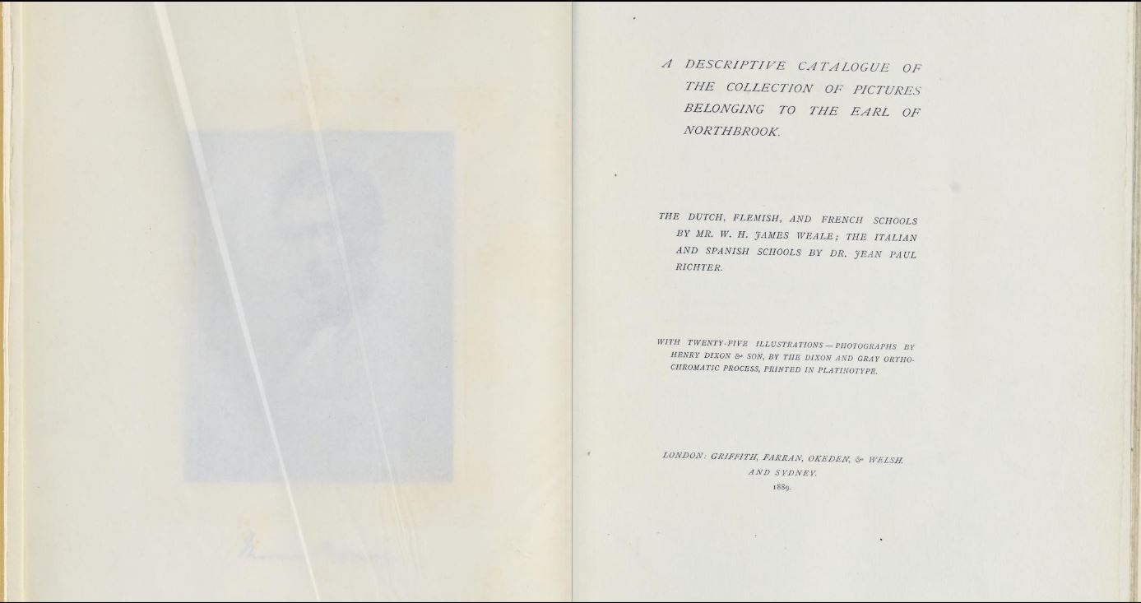

Slide 4
Background
British banking/political dynasty
Large collection, unusually well documented
Collection variety
Giovanni Battista Moroni, Portrait of Mario Benvenuti, c. 1560, The John & Mable Ringling Museum of Art, Bequest of John Ringling, 1936.

Slide 6
Background
British banking/political dynasty
Large collection, unusually well documented
Collection variety
…we’ve got heaps.
Giovanni Battista Moroni, Portrait of Mario Benvenuti, c. 1560, The John & Mable Ringling Museum of Art, Bequest of John Ringling, 1936.

Slide 7
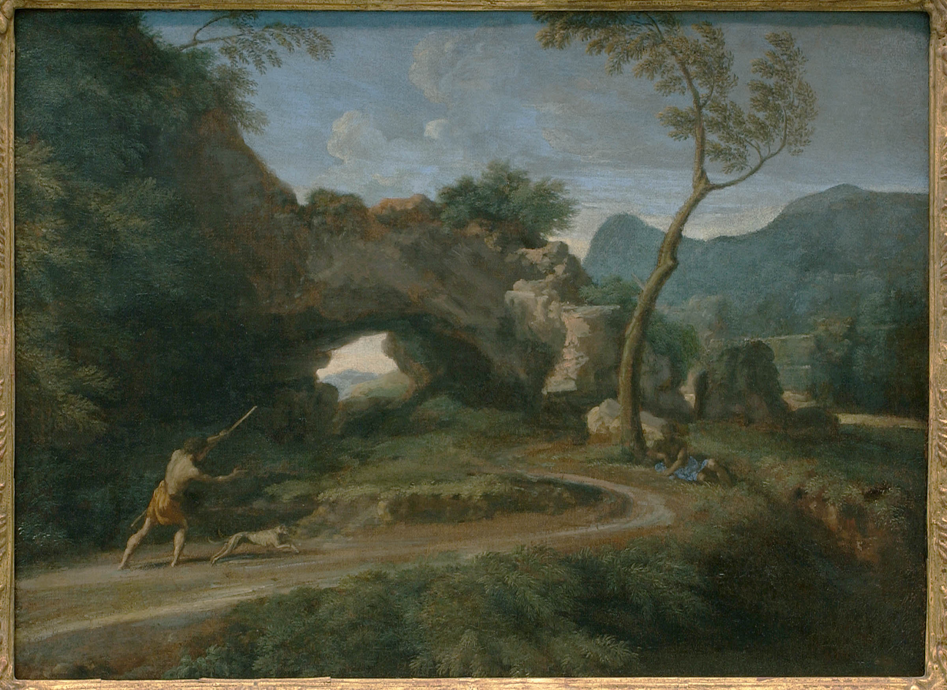
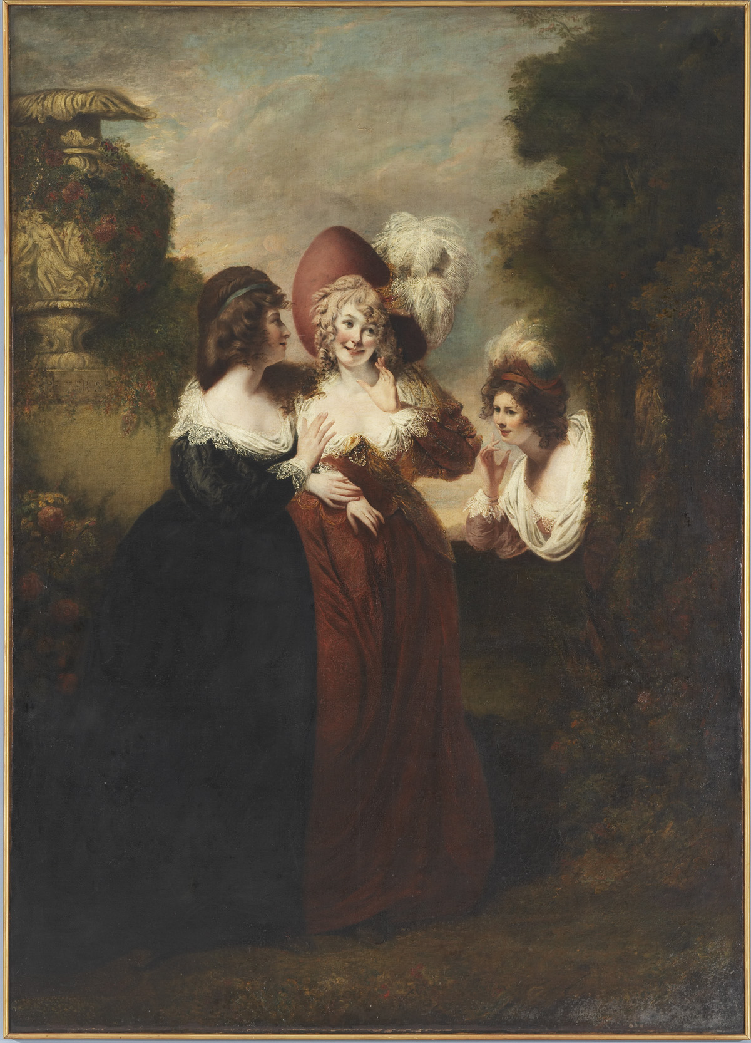
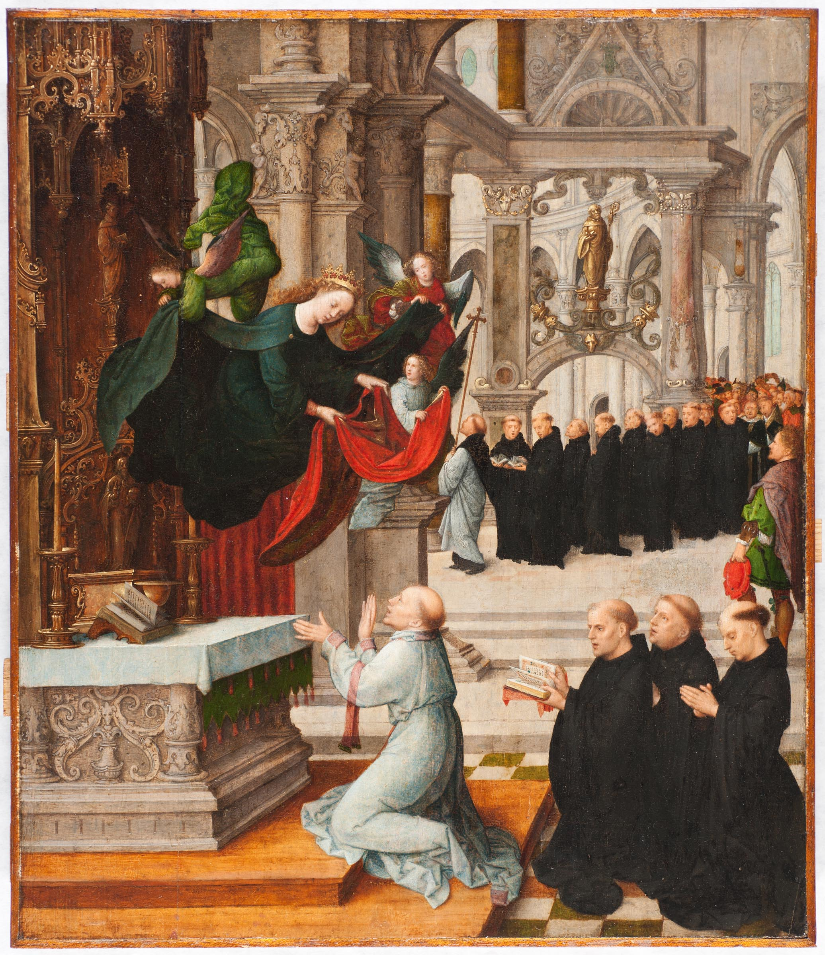
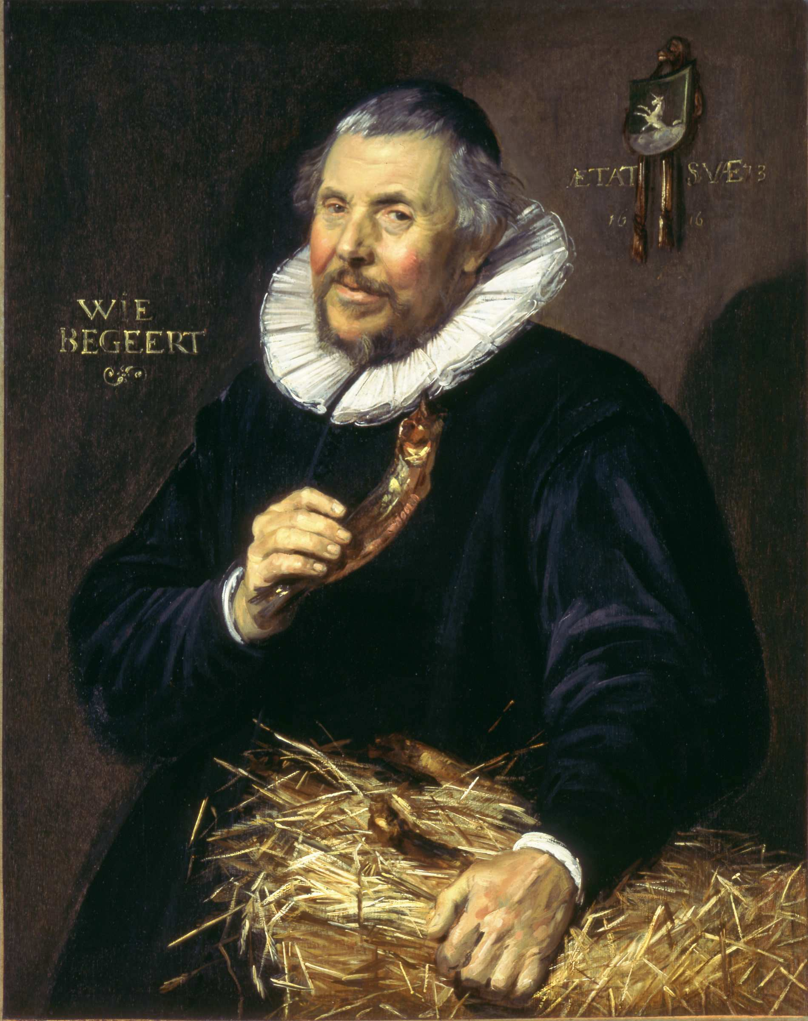
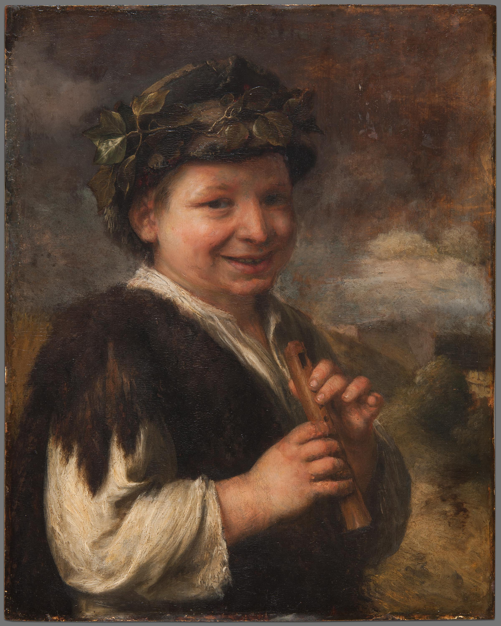
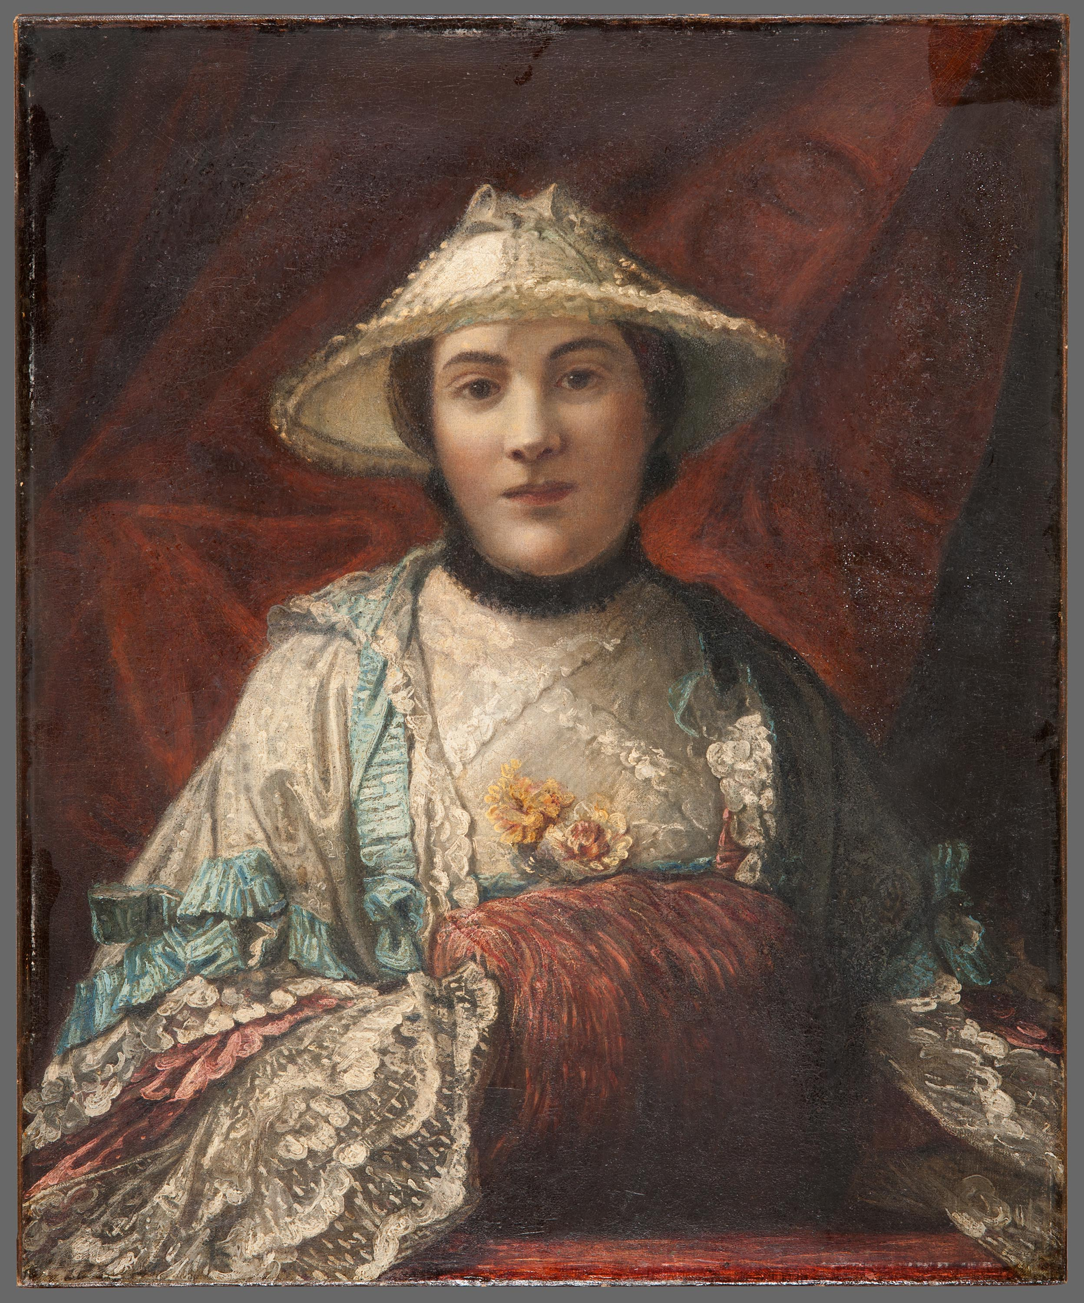
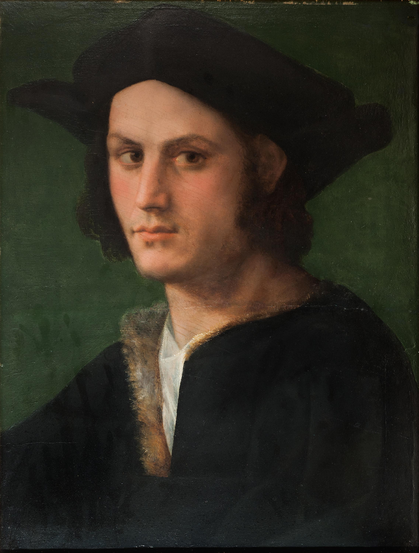

Slide 8
Background
British banking/political dynasty
Large collection, unusually well documented
Collection variety
…we’ve got heaps.
Lots of other museums do, too!
Giovanni Battista Moroni, Portrait of Mario Benvenuti, c. 1560, The John & Mable Ringling Museum of Art, Bequest of John Ringling, 1936.

Slide 9
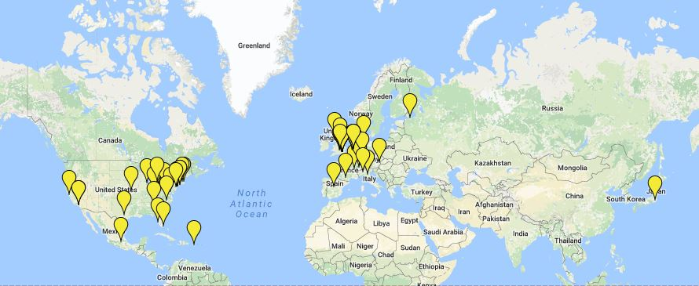
Present Locations

Slide 10
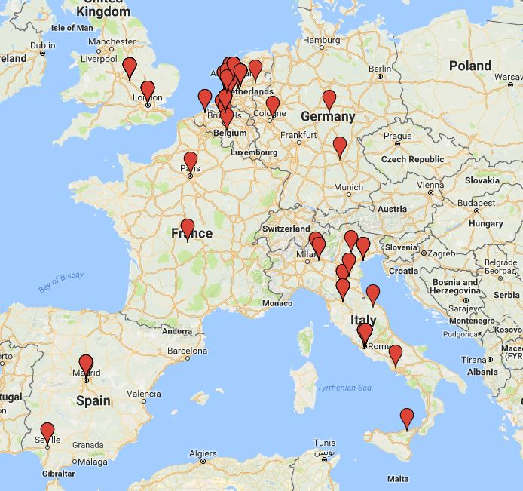
Origins

Slide 11
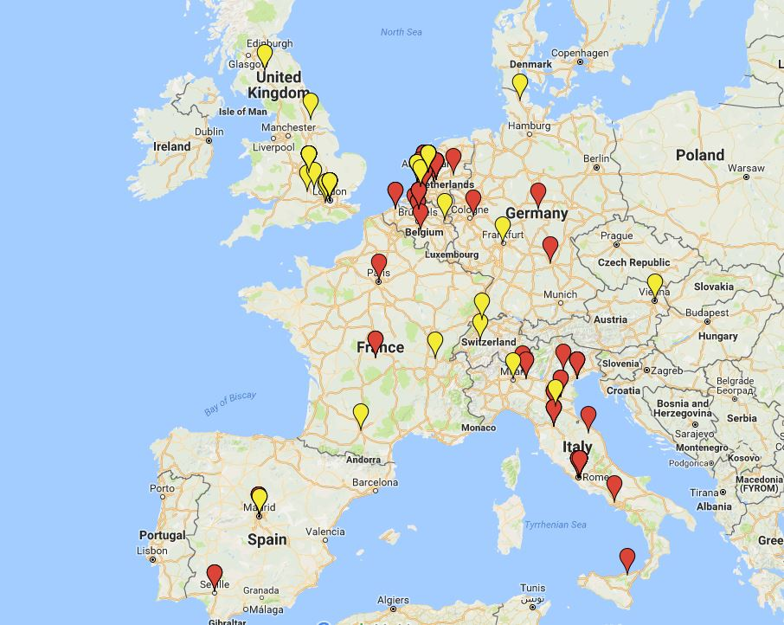
Origins & Present Locations

Slide 12
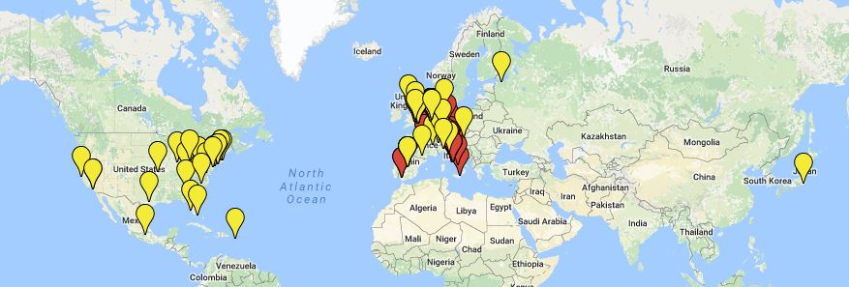
Origins & Present Locations

Slide 14
Lunch
Lunch Break 12PM to 1PM
Optional Gallery Tour 1PM to 1:30PM

