Slide 1
Notes:
Opener

Slide 2
Asian Art Provenance:
Research and data at the Freer|Sackler
21st –Century Digital Provenance
Carnegie Museum of Art Pittsburgh, Pennsylvania
October 14, 2016
Jeffrey Smith
Assistant Registrar for Collections Information
Freer|Sackler
smithje@si.edu | 202-633-0348
Notes:
Title slide (art optional)

Slide 3
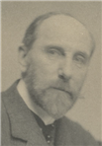
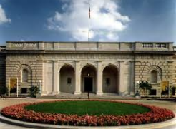
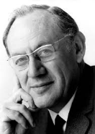
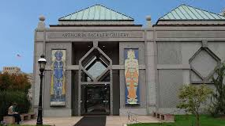
The Freer|Sackler collections
Freer Gallery of Art
opened in 1921
41,313 objects
American art
Ancient Egyptian art
Ancient Near Eastern Art
Arts of the Islamic World
Biblical Manuscripts
Chinese art
Contemporary art
European art
Greek and Roman art
Japanese art
Korean art
South Asian and Himalayan art
Southeast Asian art
Arthur M. Sackler Gallery
opened in 1987
Notes:
Interior pages

Slide 4
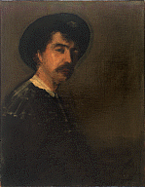
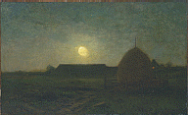
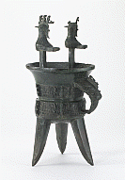
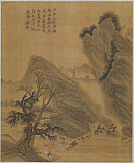
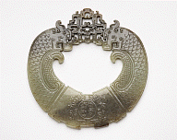
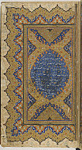
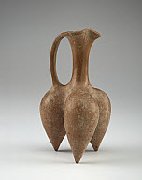
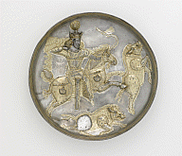
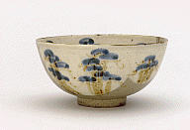
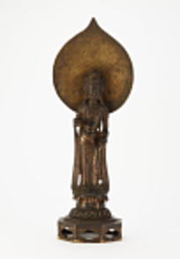
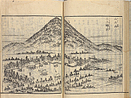
Freer|Sackler collection highlights
American art of the Aesthetic Movement
James McNeill Whistler
Chinese bronzes, jades, paintings, sculpture
Islamic manuscripts
Ancient Near Eastern Art
Asian ceramics
Japanese painting,
graphic arts
Notes:
Interior pages

Slide 5
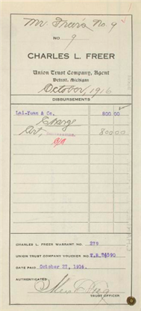
The Freer|Sackler Archives
Over 160 collections, including:
Charles Lang Freer Papers
correspondence, diaries, art inventories, vouchers
collection level records
finding aids
Personal, professional papers
archaeologists, collectors, dealers, and artists
Henri Vever
Abel William Bahr
Yatsuhashi Haramuchi Family
John Calvin Ferguson Family
Photography and Graphics
Empress Dowager photographs
Antoin Sevruguin photographs
Notes:
Interior pages

Slide 6
Freer|Sackler provenance research
WWII-era research only
2000 First coordination with Smithsonian initiatives
2002 Claim received against Chinese Zhou dynasty vessel
2004-2006 First WWII-era research on 204 objects from
dealers von der Heydt, C.T. Loo, & Tonying
2007 L. Stein Art Research hired to provide guidance for continuing research
2008 Two researchers hired for further research on Chinese collections
Adoption of a standardized format for provenance text
Guidelines for expressing variables of custody and ownership
Notes:
Interior pages

Slide 7
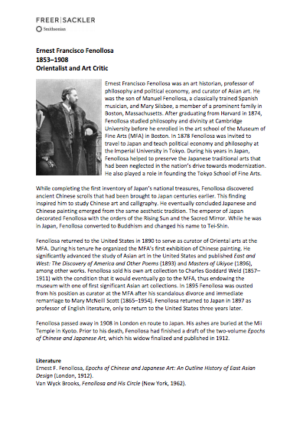
Freer|Sackler provenance research
WWII-era & general collections provenance
2008 – present
At the end of the first phase of WWII-era research:
11,934 records identified as WWII-provenance concerns
164 – gap, 95 – no gap, 11,675 – review pending
Smithsonian funding helps to continue minor research
and complete records with unformatted provenance text
David Berg Foundation funding supports research on key dealers and collectors
and the creation of biographies
Provenance data goes online, resource pages created
Ongoing review of new acquisitions, “on hold” records
Notes:
Interior pages

Slide 8
Freer|Sackler provenance research
Understanding the implications of new technology and new tools
Currently...
Partnership with the Carnegie Museum of Art and Yale Center for British Art to establish an ontology for provenance using the CRM
Immersion in the CRM and the world of linked data
Refining and standardizing provenance data in light of what has been learned
Mapping Freer|Sackler data to the CRM
Creating linked data for Freer|Sackler provenance
Understanding linked data for search
Notes:
Interior pages

Slide 9
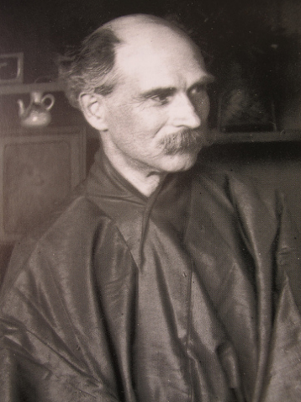
Freer|Sackler provenance data
Constituents
1,580 individual records for acquisition-related constituents
1,703 individual records for previous owners
Life dates
Alternate names
Geography
Biographical text
Related Constituents (family, business partners, businesses)
Images
Hyperlinks to digitized archival material and related web resources (Wikipedia)
ULAN URLs
Notes:
Interior pages

Slide 10
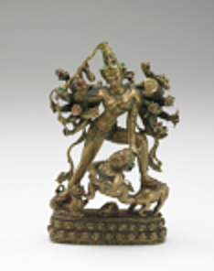
Freer|Sackler provenance data
Objects
19,368 objects with “complete” provenance online
Provenance text
Related research notes
Curatorial Remarks (not yet online)
Database links to acquisition source & previous owner Constituent records
Seals, marks, and inscriptions
Links to digitized archival material, comparanda, and related web resources
Identifying distinct provenance projects – the Pulverer Collection
Notes:
Interior pages

Slide 11
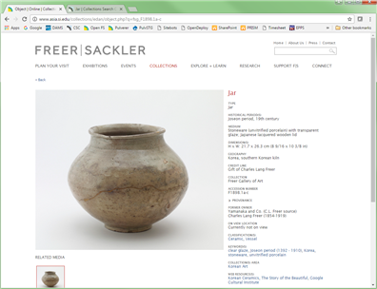
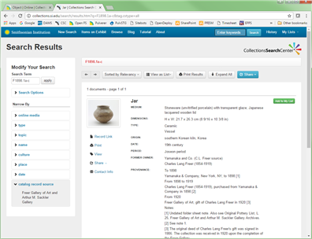
Freer|Sackler provenance online
Open F|S asia.si.edu/collections
SI Search Center collections.si.edu
Provenance text
Future links to previous owner records
SI Libraries, Archives, and Museums
Future “Authority” records
Provenance data also included in F|S online scholarly catalogues
Notes:
Interior pages

Slide 12
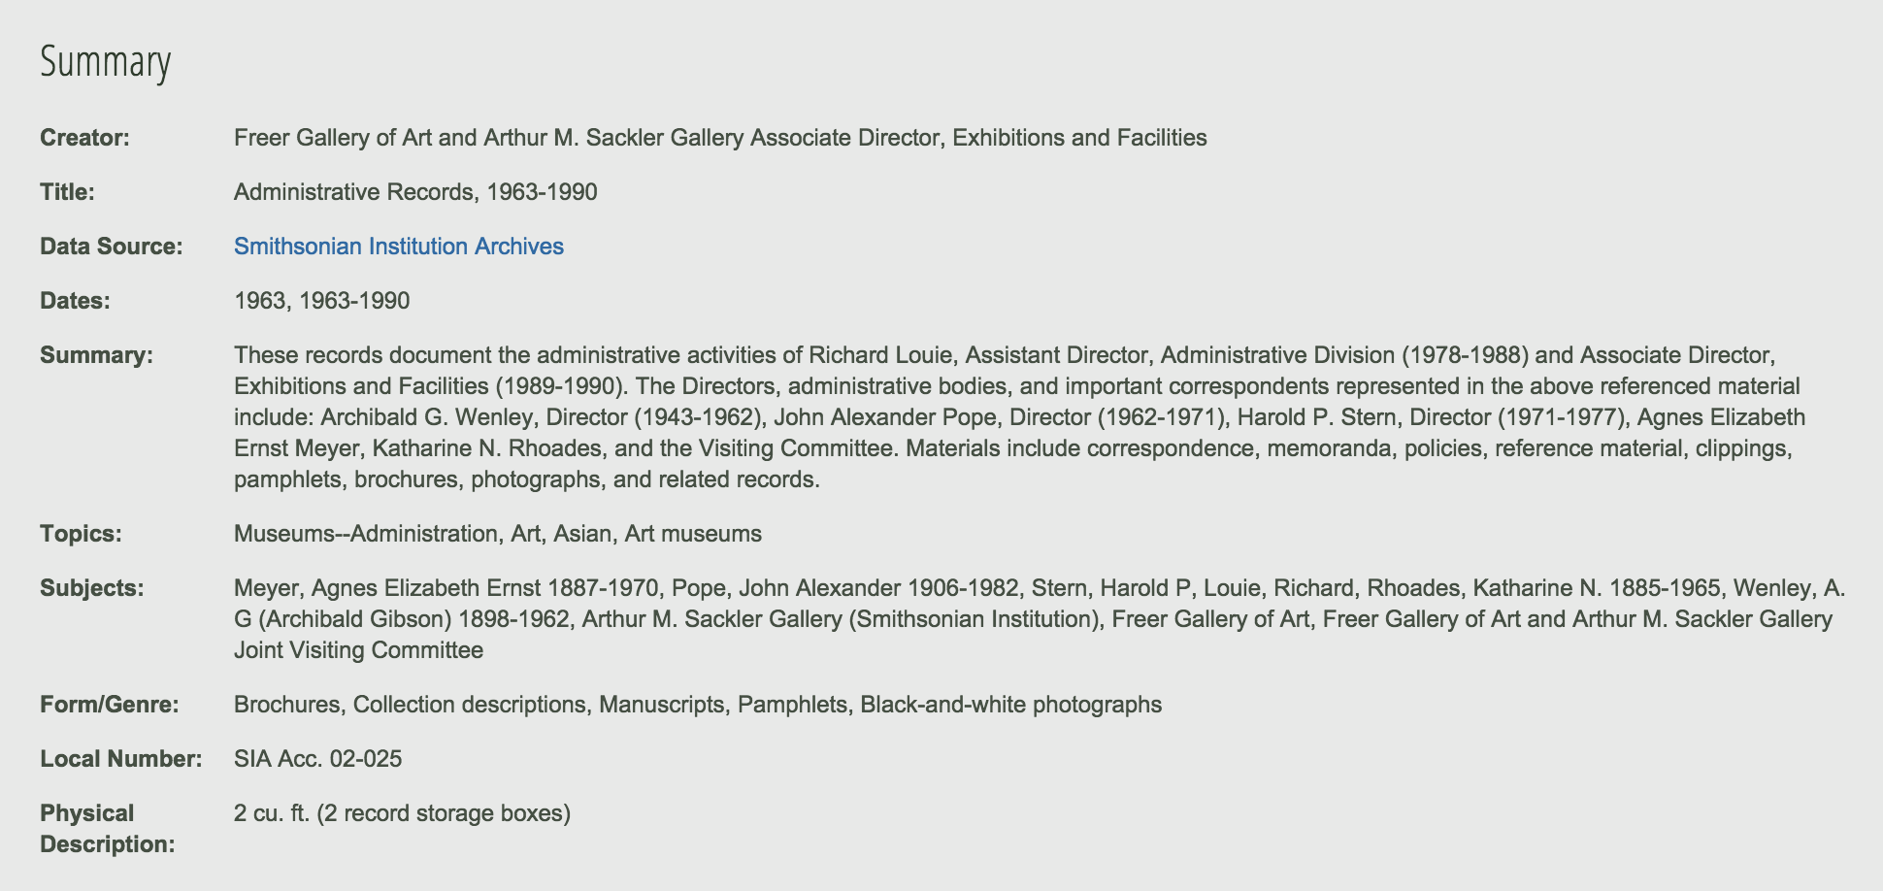
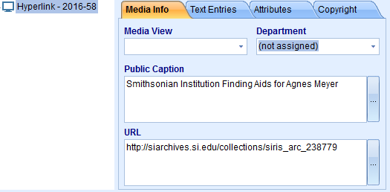
Linking to digitized Freer|Sackler Archival records
Provides URLs for both finding aids and item-level records
Archival records include related accession numbers in metadata
Notes:
Interior pages

Slide 13
The mandate to share
Support and direction from leadership makes a difference
Jane Milosch and SPRI – the Smithsonian Provenance Research Initiative
Richard Kurin, Undersecretary for History, Art and Culture
Julian Raby, Director, Freer|Sackler
Beth Duley, Head of Collections, Freer|Sackler
The goal to realize provenance search across multiple institutions
Support for the research process & the needs of researchers
Notes:
Interior pages

Slide 14
A search portal for Asian provenance
Using linked data as a common platform
Using the newly developed CRM Ontology
With the use of CRMinf
Scalable
to search multiple sets of museum data
to accommodate all of each museum’s data
and allow grouping by “keyword” sets – (WWII-era
Useful, and Innovative
Combine the advantages of linked data visualization
with indexing & access to deeper material
With the ability to save summaries of sets of data
Notes:
Interior pages

Slide 15
Towards a search portal for Asian provenance
research – provenance text – relational data – linked data – search
Resume WWII provenance research
Using the Carnegie Elysa tool to structure text and generate linked data
Incorporate new practices of linking & developing relational data
Create TMS Event records for significant auctions, exhibitions
With an eye towards the evolution of the provenance text format
Host a two-day workshop to explore the path from research to search
For American museums with Asian collections, European partners
To explore and understand elements for a successful search interface
Establish wire-frame models for the interface
Secure funding to create a search portal for Asian provenance
Notes:
Interior pages

Slide 16
Notes:
Closer

